Slide 1

System & Network Administration
By eman mehmood

Slide 2
Processes, Services and Scheduled Tasks
In this lecture we will learn:
What processes are and how they work
How administrators monitor and control processes
What operating-system services are
How Linux and Windows manage services
What scheduled tasks are
How administrators automate routine work

Slide 3
What Is a Process?
A process is a program that is currently being executed by the operating system.
A program stored on a disk is not necessarily a process. When the operating system loads that program into memory and starts executing it, it becomes a process.
Example
When you open Google Chrome:
Chrome program → loaded into memory → execution begins → Chrome process

Slide 4
Continue…
Similarly:
Notepad.exe → running → Notepad process
A process requires several resources, including:
CPU time
Main memory (RAM)
Open files
Network connections
Input/output resources
The operating system keeps information about these resources so that it can manage each process.

Slide 5
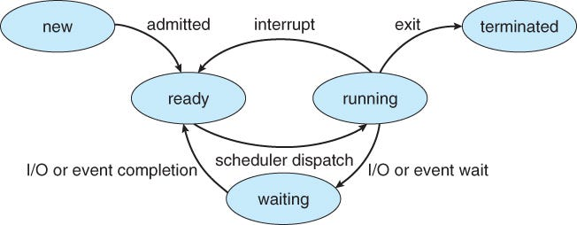
Process Lifecycle

Slide 6
Process Lifecycle
A process normally passes through several states during its lifetime.
New: The process is being created.
Ready: The process is waiting for CPU time.
Running: The CPU is currently executing the process.
Waiting/Blocked: The process is waiting for an event, such as disk or network I/O.
Terminated: The process has finished execution or has been stopped.

Slide 7
Continue…
Why does an administrator care?
Understanding process states helps administrators identify problems such as:
A process consuming too much CPU
A process waiting for I/O
A process that has stopped responding
A process that never terminates
The Linux administration references emphasize understanding the process lifecycle as a fundamental part of process control.

Slide 8


Process ID (PID)
Every running process is normally assigned a unique Process ID (PID).
The operating system uses the PID to identify and manage a particular process.
Example in Linux
You may see:

Slide 9
Continue…
Here:
1245 identifies the Bash process
1821 identifies the Python process
An administrator can use a PID to:
Monitor a process
Change its priority
Send signals
Stop a process
Investigate resource consumption
Important idea
PID = identity of a running process

Slide 10
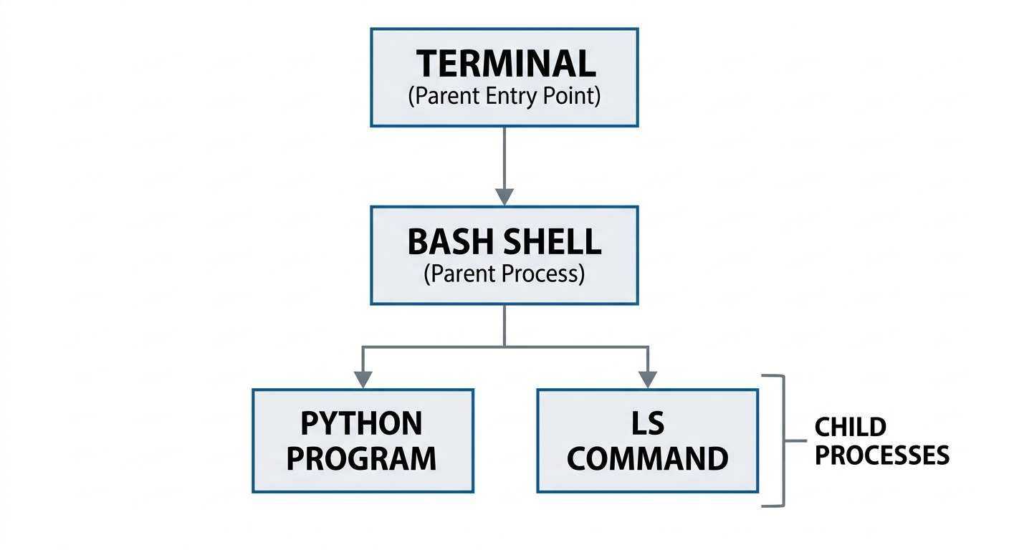
Parent and Child Processes
Processes can create other processes.
The process that creates another process is called the parent process.
The newly created process is called the child process.

Slide 11
Continue…
Here, Bash may create processes to execute commands.
Linux administrators can examine process relationships to understand how programs were started and where they originated.
Why is this useful?
Suppose a server has an unexpected process running.
The administrator can investigate:
Who started it? → Which parent process created it? → What command is it executing?
This is useful for troubleshooting and security investigations.

Slide 12



Monitoring Processes in Linux
Linux provides several commands for examining running processes.
ps Displays information about currently running processes.
A more detailed view can be obtained using:
top Provides an interactive view of processes and resource usage.

Slide 13
Continue…
It can show:
CPU usage
Memory usage
Process ID
Process owner
Process state
Running time

Slide 14

Continue…
pstree Displays processes in a parent-child hierarchy.
These tools are fundamental process-management utilities discussed in Linux administration references.

Slide 15



Controlling Processes in Linux
A system administrator sometimes needs to control a process.
Linux provides signals for communicating with processes.
Common command For example
This sends a signal to process 1821.
A process can also be terminated more forcefully when necessary:

Slide 16
Continue…
Important warning
kill -9 should not be the first choice.
Administrators should normally attempt a normal termination first because applications may need an opportunity to:
Save data
Close files
Release resources
Shut down cleanly
Basic approach
Identify → Investigate → Attempt graceful termination → Force only if necessary

Slide 17



Process Priority: nice and renice
Linux allows administrators to influence how much CPU scheduling priority a process receives.
The nice value is related to process scheduling priority.
Start a process with a specific priority For example:
Change an existing process

Slide 18
Continue…
Why is this useful?
Imagine a server running:
Database service
Web server
Backup script
A backup operation might consume significant CPU resources.
An administrator may adjust its priority so that important interactive services remain responsive.

Slide 19


